Slide 1

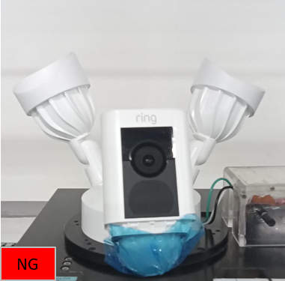
OBA issue : Device can not boot up
問題描述 (5W2H) |  | Containment Action & Risk Assessment | (Root cause) | (Corrective action) | DRI | Status
When 何時 | 19/May/2026 10:20 AM | Containment Action: 1. Do not pass to FG. 2. SI arrange Ops to sorting test OBA1 1000pcs at OBA station DRI:SI/ A Tung DD:05/21 3. PQA please increase - OBA2 rate to maximum capacity before having other sorting methods. DRI:Oanh/A Thuong DD:05/21 Risk assessment: | Root cause: Light Fixture abnormal PE analysis: 1. Took devices NG retest 3 times at OBA station Devices have stil fail 2. Check history data of devices NG No abnormality found ( No R_ history , No repair history) 3. Dis-assemble bottom cover of light fixture and inspection There’s no any abnormal 4. Swap light fixture for confirm phenomenon →Device test Pass after swap Light fixture 5. Taking NG Light fixture, provide power for checking → The light fixture test failed (cannot boot up) | Cause Correct Action: Send NG Light fixture to vendor analysis - Material code : 55-0035771 DRI: SQE/ Vic DD:06/10 Escape Correct Action: 1. TE set up program, SI proceed sorting 1000pcs light fixture DRI: TE_Ashan/ SI_A bei DD:05/21 | PE/SQE | On-going
Who 何人 | OBA1
Where 何地 | B84L3P1
What 何事 | Project: Goldfish Model: U73J041.03 DSN: GT51J521618300WK
Why 為何 | Can not boot up the device
How 怎樣 | During OBA testing, the OBA staff found that when device can not boot up
How many 多少 | 1F
QA | OBA1
Picture

